Slide 1
Occupational Safety Engineering - Automation and Robots Safety
Boyi Hu, Ph.D.
Assistant Professor

Slide 2
Learning Objectives
Explain the impact of automation on the workplace
Explain the concept of human-robot interaction
Summarize the hazards of human-robot interaction and corresponding injury prevention strategies
Safety precautions when automation and robots are used
Strategies for minimizing the safety problems of automation
Summarize the most pressing challenges in this area

Slide 3
Impact of Automation on the Workplace
Goal: enhance productivity, quality and competitiveness
A continuum with different phases:
Age of hand tools and manual work
Age of mechanization (i.e., industrial revolution)
Islands of automation: stand-alone computer, etc.

Slide 4
Impact of Automation on the Workplace
Changing the emphasis from physical work to automated mechanical work
Changing the emphasis from physical to mental work
Increasing the level of stress on workers and supervisors
Eliminating some jobs that cause morale problems
Technology acceptance issue
Making works feel a loss of control and onset of helplessness
Notes:
Try to find the curve from the Science paper that the both ends of workforce are safe and resilient to automation and AI

Slide 5
Impact of Automation on the Workplace
﻿The main effects of pre-robotics automation have been on a relatively narrow swath of routine, highly structured and repetitive tasks
This has been a key reason that labor demand has fallen for jobs in the middle of the skill and wage spectrum, like clerks and factory workers, whereas demand at the bottom (e.g., janitor or home health aide) and top (e.g., physicians) has held up in most advanced countries
Notes:
Try to find the curve from the Science paper that the both ends of workforce are safe and resilient to automation and AI

Slide 6
Impact of Automation on the Workplace
Increased levels of stress:
Rapid, continual change - workers must continually learn and relearn skills with little or no relief
Accompanying feeling of helplessness
Workplace stress
Physiological, psychological and social factors

Slide 7
Are risk factors being changed by Automation?
Reduce the number of low-force repetitive movements
Twisting, pinching and flexing – reduce risk of MSDS
Not necessarily the case always
Example: warehouse workers
Traditional: walking 12 miles a day for order picking, 100 items per shift
Amazon smart warehouse: minimal walking distance, 100 items per hour

Slide 8
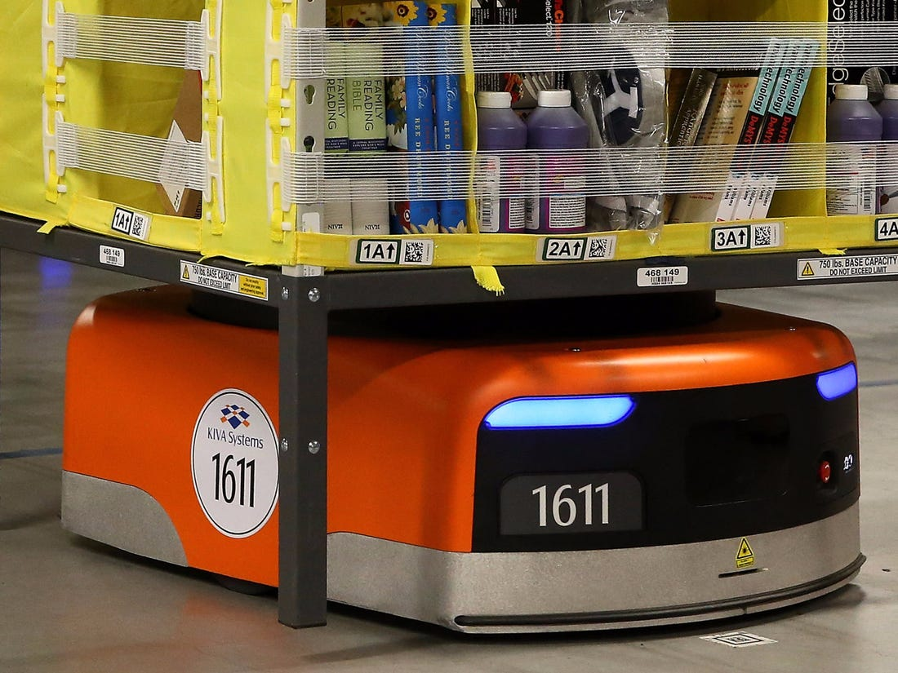
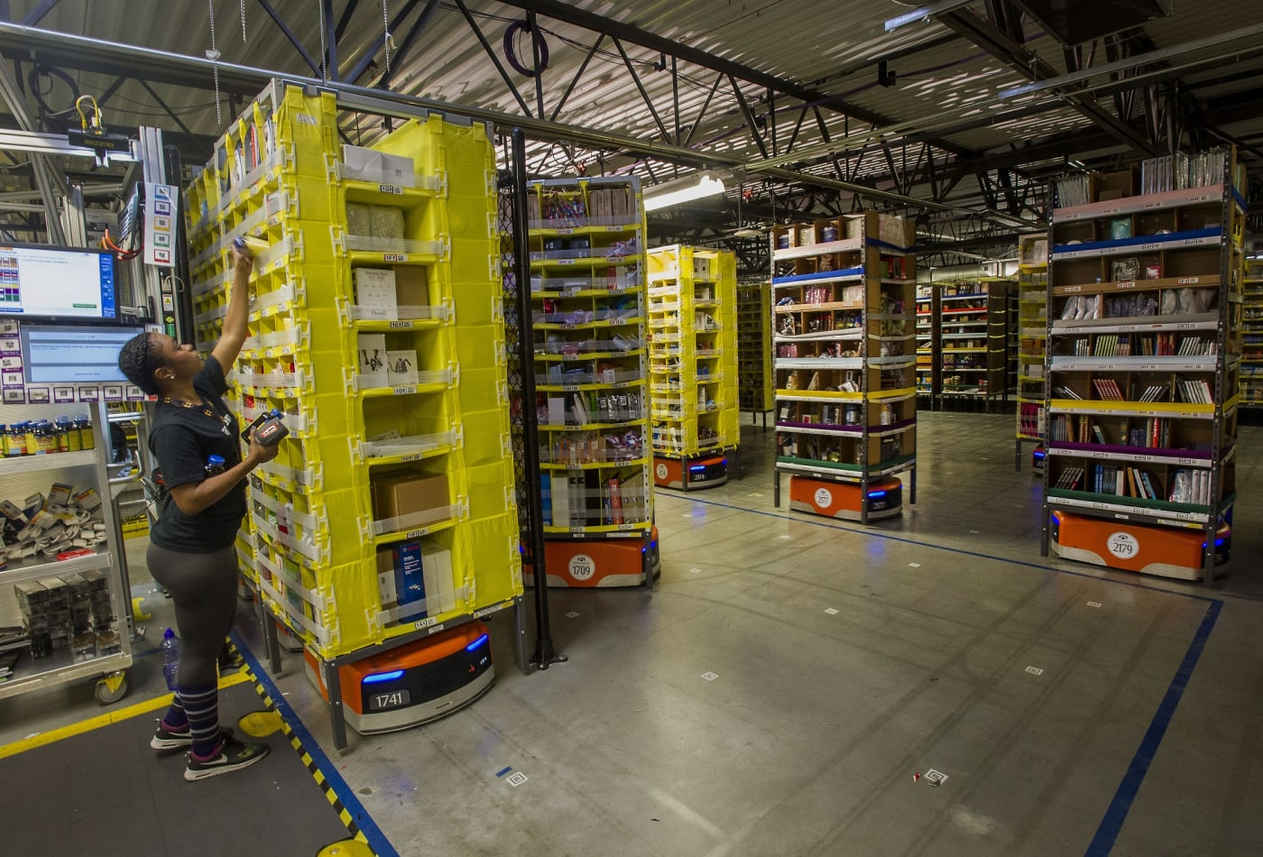
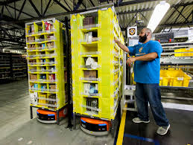
Examples
Notes:
Amazon Kiva:
Early days: https://www.youtube.com/watch?v=6KRjuuEVEZs
Current: https://www.youtube.com/watch?v=TUx-ljgB-5Q (safety vest)
https://www.youtube.com/watch?v=JXkMevbjga4 (warehouse)
Walmart:
https://www.youtube.com/watch?v=AqAPFXNyF4M AlphaBot

Slide 9
Human Robot Interaction – A brief intro
Every tool to enhance human work efficiency comes with new safety and health hazards. For robots:
The ability to acquire intelligence (ethical issues), examples?
Surgical robots, driverless cars, unmanned weapons
Their flexibility and range of motion
Speed of movement
Power
Direct and indirect interaction, frequent and occasional interaction, remote or proximity interaction
Notes:
Science paper:
https://science.sciencemag.org/content/sci/352/6293/1573.full.pdf

Slide 10
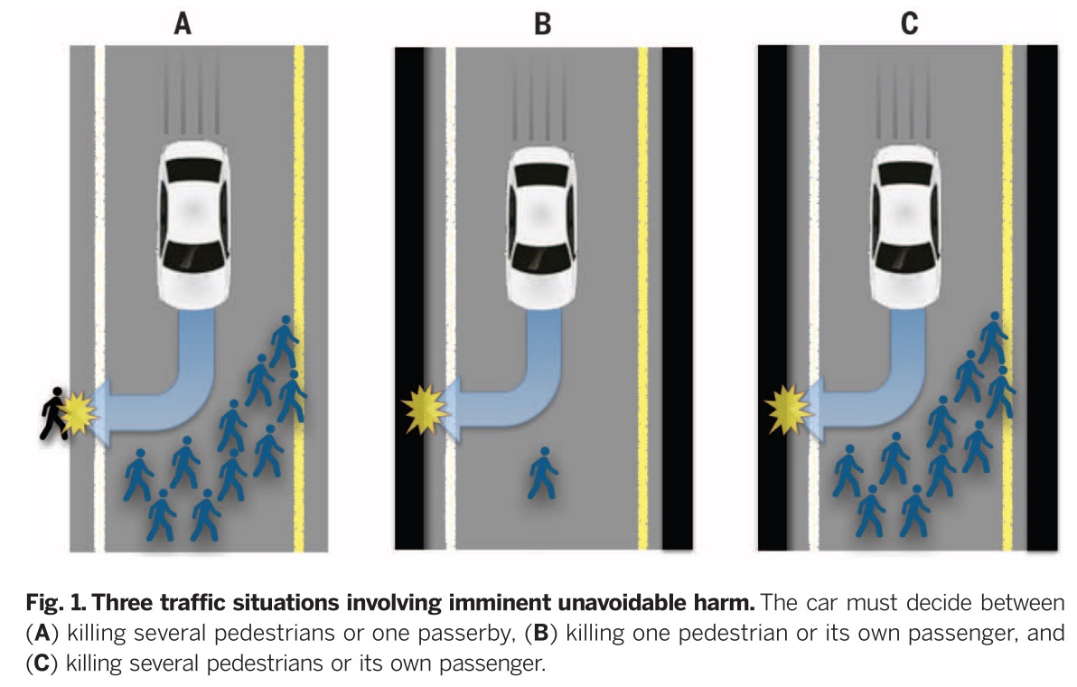
Let Us Discuss
Notes:
Science paper:
https://science.sciencemag.org/content/sci/352/6293/1573.full.pdf

Slide 11
Safety and Health Problems with Robots
General principal hazards associated with robots (by NSC)
Struck by a moving robot while inside the work envelope
Trapped between a moving part of robot and another machine
Struck by a workpiece, tool or object dropped or ejected by a robot
NIOSH FACE case (extra reading)
Autonomous car fatality

Slide 12
Minimizing the Safety and Health Problems
Barrier, no enter zone
Effective in certain scenarios, have strong weakness
Ensure glare-free, well-lighted robot site: 50-100 foot-candles
Good housekeeping
Keep the robot site free of associated hazards such as blinding light from welding machines
Equip electrical and pneumatic components of the robot with fixed covers and guards
Make sure all safeguards are in place before starting
Lockout and proper test procedures
Notes:
From a safety professional perspective
Preventive approaches after robots have been developed

Slide 13
Minimizing the Safety and Health Problems
Variance control – appropriate preventive measures
Boundary location – classification of work
Work group organization
Management support
Design process
Quality of work life – promote the morale and best interests

Slide 14
Minimizing the Safety and Health Problems
Construction of a safety fence – work envelope
Control the speed of movement inside the work fence
Installation of emergency stop device
Location of the control panel outside the safety fence
Establishment of automatic shutdown switches

Slide 15
Automated Vehicles in the Workplace
Refer to systems to achieve consistency and predictability in settings where materials must be moved repeatedly from one locations to another.
Fixed pathway
Broadcasted signals
Safety approach:
Clearly mark all path used by them
Barriers
Detection system for emergency stop
Adequate training

Slide 16
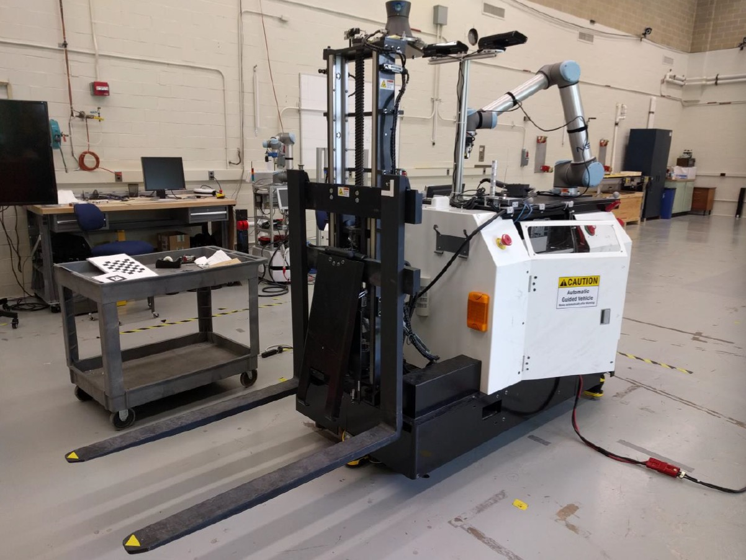
More Examples
Notes:
Source: National Institute of Standards and Technology

Slide 17
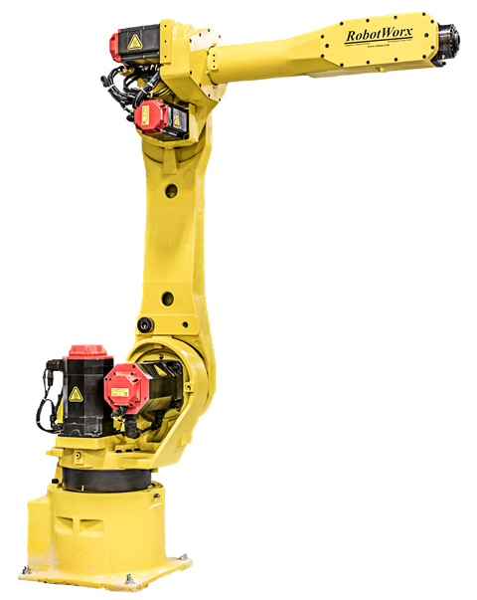
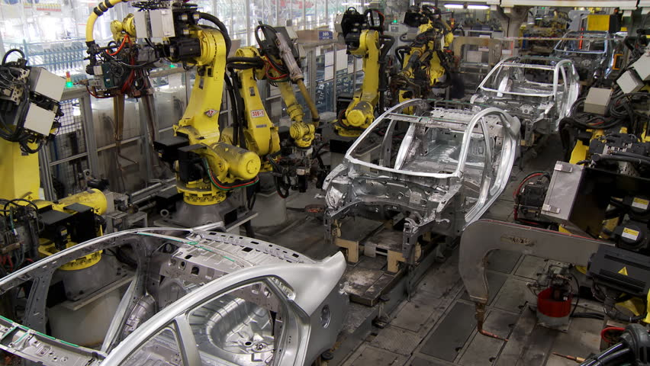
Examples: Manipulators
Notes:
Source: National Institute of Standards and Technology

Slide 18
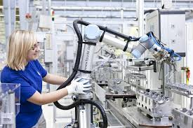
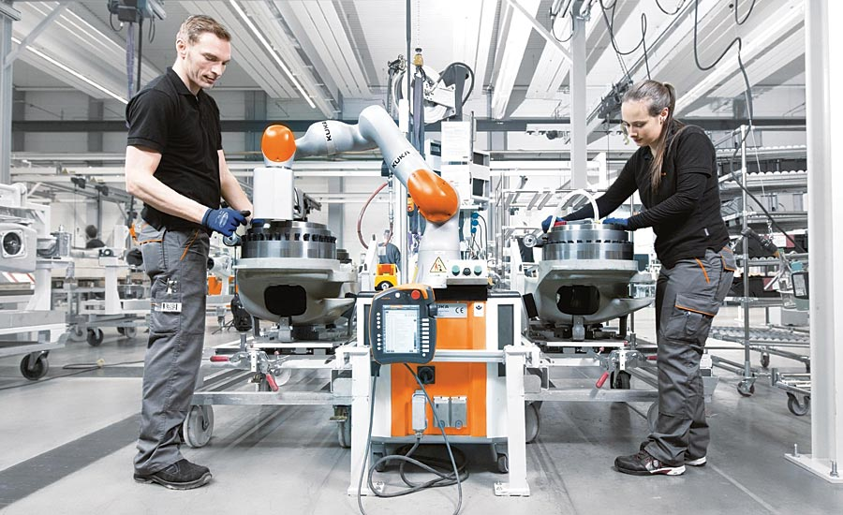

Examples: Collaborative Manipulators
Notes:
Source: National Institute of Standards and Technology

Slide 19
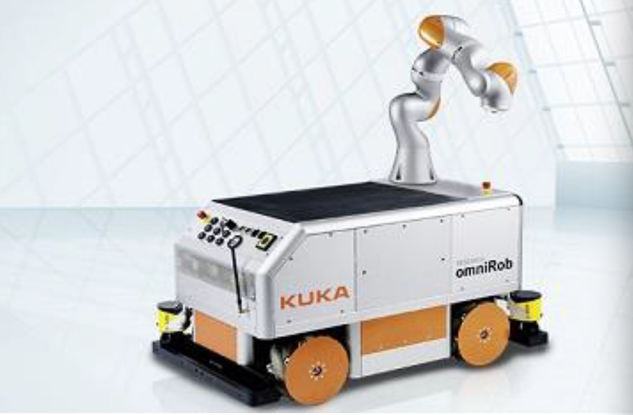
Examples: Ambulators
Notes:
Source: KUKA Laboratories, GmbH
https://commons.wikimedia.org/wiki/File:KUKA_omniRob.jpg

Slide 20
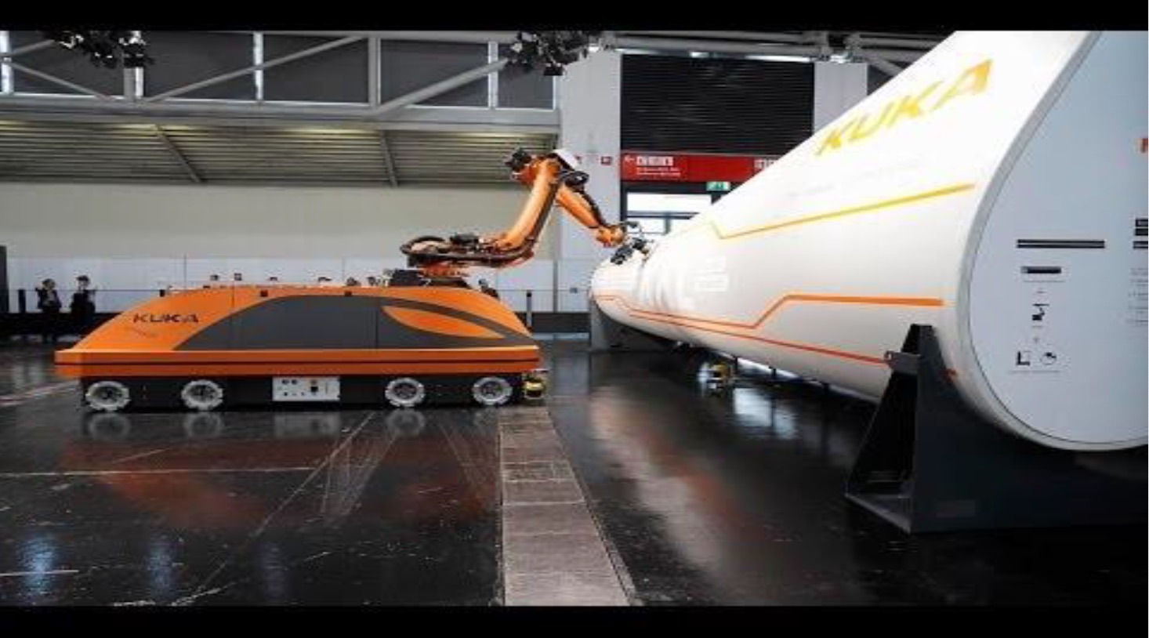
Examples
Notes:
Source: KUKA Robotics
https://www.youtube.com/watch?v=p6NwH3G0V6Y

Slide 21
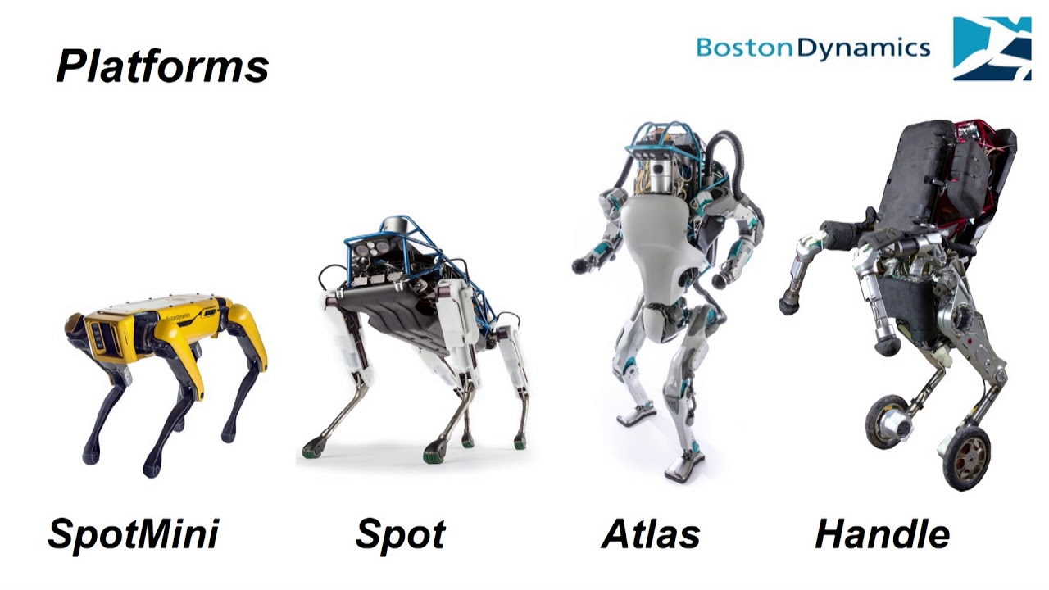
Examples
Notes:
Source: Boston Dynamics
https://www.youtube.com/watch?v=NR32ULxbjYc
Remember to check more

Slide 22
Examples
Notes:
Amazon Kiva:
Early days: https://www.youtube.com/watch?v=6KRjuuEVEZs
Current: https://www.youtube.com/watch?v=TUx-ljgB-5Q (safety vest)
https://www.youtube.com/watch?v=JXkMevbjga4 (warehouse)
Walmart:
https://www.youtube.com/watch?v=AqAPFXNyF4M AlphaBot

Slide 23
Occupational Safety Engineering - Robotics Safety Standards
Boyi Hu, Ph.D.
Assistant Professor

Slide 24
Topics
Robotics related safety standards
Background
Existing standards
Key questions/topics
2
Notes:
Standards: OSHA https://www.osha.gov/SLTC/robotics/standards.html
https://www.osha.gov/dts/osta/otm/otm_iv/otm_iv_4.html Word list

Slide 25
Definitions: Robot
https://www.merriam-webster.com/dictionary/robot: a mechanism guided by automatic controls, often repetitive tasks
ISO 8373:2012 (Robots and robotic devices — Vocabulary): actuated mechanism programmable in two or more axes with a degree of autonomy, moving within its environment, to perform intended tasks
2

Slide 26
Definitions: Industrial Robot
ANSI/RIA (American National Standards Institute) R15.06-2012 (ISO 10218-1:2011): automatically controlled, reprogrammable multipurpose manipulator, programmable in three or more axes, which can be either fixed in place or mobile for use in industrial automation applications
UL 1740 (Standard for Robots and Robotic Equipment): automatically controlled, reprogrammable multipurpose machine, programmable in several degrees of freedom, which can be either fixed in place or mobile
Notes:
Check the roadmap paper and find the numbers

Slide 27
Existing Standards - OSHA
No specific OSHA standards for the robotics industry. We list OSHA standards and documents related to robotics.
General Industry (29 CFR 1910)
Subpart J – General Environmental Controls
1910.147, The control of hazardous energy (lockout/tagout)
Subpart O – Machinery and Machine Guarding
1910.211, Definitions
1910.212, General requirements for all machines. States that any machines that creates a hazard must be safeguarded in order to protect the operator and other employees.
Notes:
Robotic Industries Association

Slide 28
Existing Standards - OSHA
Depending on the material being processed, these standards are also applicable （Still Subpart ):
1910.213, Woodworking machinery requirements
1910.215, Abrasive wheel machinery
1910.216, Mills and calenders in the rubber and plastics industries
1910.217, Mechanical power presses
Subpart S – Electrical
1910.333, Selection and use of work practices
Notes:
Robotic Industries Association

Slide 29
Existing Standards – R15.06
American National Standards Institute (ANSI)
R15.06, Industrial Robots and Robot Systems - Safety Requirements. Provides safety requirements for industrial robot manufacture, remanufacture, and rebuild (Part 1); and robot system integration/installation (Part 2). R15.06 (ANSI/RIA R15.06-2012) is the U.S. National Adoption of the ISO 10218-1,2:2011.
RIA TR R15.306-2016 ("TR 306"), Task-Based Risk Assessment Methodology. Describes one method of risk assessment that would comply with the R15.06 requirements.
Notes:
Robotic Industries Association

Slide 30
Existing Standards – R15.06
RIA TR R15.406-2014 ("TR 406"), Safeguarding. Explains how to design a system of safeguards to protect human workers in an industrial environment that also contains robot system(s). TR 406 contains greater detail than the 2012 R15.06 standard.
RIA TR R15.506-2014 ("TR 506"), Applicability of R15.06-2012 for Existing Industrial Robot Applications. The R15.06 standard is forward-looking; that is, its primary topic is the installation of an all-new robot system. TR 506 explains how to take the 2012 R15.06 standard into account for existing robot systems.
Notes:
Robotic Industries Association

Slide 31
Existing Standards – R15.06
RIA TR R15.606-2016 ("TR 606"), Collaborative Robot Safety. Explains safety requirements specific to collaborative robots and robot systems and is supplemental to the guidance in ANSI/RIA R15.06. TR 606 is the U.S. National Adoption of the ISO/TS 15066:2016.
RIA TR R15.806-2018 ("TR 806"), Testing Methods for Power & Force Limited Collaborative Applications. Describes methods to test and verify that the forces exerted by a collaborative robot system remain within the allowable limits described in TR 606 (ISO/TS 15066).
Notes:
Robotic Industries Association

Slide 32
Existing Standards – ANSI
B11.0-2015, Safety of Machinery – General Requirements and Risk Assessment. Applies to new, existing, modified, or rebuilt power-driven machines, not portable by hand while working, used to shape and/or form metal or other materials by cutting, impact, pressure, electrical, or other processing techniques, or a combination of these processes. This can be a single machine, a machine tool, or a machine tool system(s), and may include industrial robot(s) and robot system(s). Also contains guidance on performing risk assessments.
Notes:
Robotic Industries Association

Slide 33
Existing Standards – ANSI
B11.20-2017, Safety Requirements for Integrated Manufacturing Systems. Specifies the safety requirements for the design, construction, set-up, operation, and maintenance (including installation, dismantling and transport) of integrated manufacturing systems, which may include industrial robot(s) and robot system(s).
Notes:
Robotic Industries Association

Slide 34
Existing Standards – ISO
TC 299, Robotics. Develops high quality standards for the safety of industrial robots and service robots to enable innovative robotic product to be brought onto the market. In addition, develops standards in fields like terminology, performance measurement and modularity.
ISO 10218-1: 2011, Robots for industrial environments - Safety requirements - Part 1: Robots. Specifies requirements and guidelines for the inherent safe design, protective measures, and information for use of industrial robots. It describes basic hazards associated with robots and provides requirements to eliminate or adequately reduce the risks associated with these hazards.
Notes:
Robotic Industries Association

Slide 35
Existing Standards – ISO
ISO 10218-2:2011, Robots for industrial environments – Safety requirements – Part 2: Robot systems and system integration. Specifies requirements and guidelines for the safe integration of an industrial robot into a complete robot system, which includes end-effectors and other related equipment. This document describes basic hazards associated with robot systems and provides requirements to eliminate or adequately reduce the risks associated with these hazards.
Notes:
Robotic Industries Association

Slide 36
Existing Standards – ISO
In the U.S., ISO 10218-1,2:2011 has been Nationally Adopted as the single U.S. standard ANSI/RIA R15.06-2012
ISO 10218 does not apply to non-industrial robots although the safety principles established in ISO 10218 may be utilized for these other robots. Examples of non-industrial robot applications include, but are not limited to: undersea, military and space robots; tele-operated manipulators; prosthetics and other aids for the physically impaired; micro-robots (displacement <1 mm); surgery or healthcare; and service or consumer products.
Notes:
Robotic Industries Association

Slide 37
Existing Standards – ISO
ISO/TS 15066:2016, Collaborative Robot Safety. Provides important information about how to implement a collaborative robot system in a manner that maintains safety for the human operator. In the U.S., this ISO TS has been Nationally Adopted as TR 606.
ISO/TR 20218-1:2018, Safety Design for End-effectors. Describes how an industrial robot system should handle and manage end-effectors (end-of-arm tooling or EOAT) to maintain human safety, in either a collaborative or non-collaborative industrial environment.
Notes:
Robotic Industries Association

Slide 38
Existing Standards – ISO
ISO/TR 20218-2:2017, Safety Design for Manual Load/ Unload Stations. Describes how to design a Manual Load/ Unload Station (MLUS) that will be safe and effective for the human worker to use.
Notes:
Robotic Industries Association

Slide 39
Existing Standards – Others
Canadian Standards Association (CSA)
Z434-14, Industrial Robots and Robot Systems. This is the Canadian National Adoption of ISO 10218-1,2:2011.
American Welding Society (AWS)
D16.1M/D16.1, Specification for Robotic Arc Welding Safety. Identifies hazards involved in maintaining, operating, integrating, and setting up arc welding robot systems.
ASME (American Society of Mechanical Engineers)
B56.5 Safety Standard for Automatic Guided Industrial Vehicle and Automated Functions of Manned Industrial Vehicles
Language tailored to vehicles that follow a prescribed path
Notes:
Robotic Industries Association

Slide 40
Existing Standards - Others
EN 1525 (European Standards) Safety of industrial trucks. Driverless trucks and their systems
EN1526 Safety of industrial trucks. Additional requirements for automated functions on trucks
ISO3691-4 Driverless industrial trucks and their systems (committee draft)
ISO 13482:2014 Safety requirements for personal care robots
Type 1.2: Mobile servant robot with manipulator
Specifically excludes industrial robots

Slide 41
Key Issues: Safety Strategies
Traditional industrial robot safety
Separation of operator from hazards
Fencing, light curtains
AGV safety
Well-defined paths
Awareness means
Bumpers, scanners
Training

Slide 42
Key Issues
Mobility
Integrated vs. isolated controllers
Requirements
Components
Interfaces
System

Slide 43
Key Questions
New standard vs. modifications to existing standards
Framework for decision
Notes:
This slide can be linked to the book

Slide 44
Key Questions: Scope
What is ‘industrial’?
Manufacturing only?
Distribution?
Commercial?
Mobility environment
Airborne
Waterborne (on/under)
Indoor/outdoor
Mobility modality: wheels, tracks, legs

Slide 45
Key Questions: HRI
How to deal with human-robot interaction
Trained personnel vs. ‘the public’
Grocery stores
Stockroom vs. stocking shelves
Hospitals

Slide 46
Strategies
Framework for decision on new standard vs. revising related standards
Committee members reviewing related standards
May consider workload of committees responsible for related standards
Related standards: base of people familiar with requirements vs
New standard: on stop shop for requirements

Slide 47
Strategies
Use profiles, e.g.
Material handling with load/unload
Processing large parts
Simultaneous vs. independent motion
Arm only moves when base doesn’t
Coordinated arm/base motion

Slide 48
37

Slide 49
Occupational Safety Engineering - OSHA Technical Manual (OTM) - Section IV: Industrial Robots and Robot System Safety
Boyi Hu, Ph.D.
Assistant Professor

Slide 50
Learning Objectives
Introduction
Types and Classification of Robots
Hazards
Investigation Guidelines
Control and Safeguarding Personnel
1

Slide 51
Introduction
Industrial robots: programmable multifunctional mechanical devices designed to move material, parts, tools, or specialized devices through variable programmed motions to perform a variety of tasks. An industrial robot system includes not only industrial robots but also any devices and/or sensors required for the robot to perform its tasks as well as sequencing or monitoring communication interfaces.

Slide 52
Introduction
Industrial robots: programmable multifunctional mechanical devices designed to move material, parts, tools, or specialized devices through variable programmed motions to perform a variety of tasks. An industrial robot system includes not only industrial robots but also any devices and/or sensors required for the robot to perform its tasks as well as sequencing or monitoring communication interfaces.
Used to perform unsafe, hazardous, highly repetitive, and unpleasant tasks – 4D (dangerous, dull, dirty, dump)
common definitions (extra readings)

Slide 53
Introduction – Past incidents
Many robot accidents do not occur under normal operating conditions but, instead during programming, program touch-up or refinement, maintenance, repair, testing, setup, or adjustment.
Human within the robot's working envelope where unintended operations could result in injuries.

Slide 54
Introduction – Past incidents
Typical accidents have included the following:
A robot's arm functioned erratically during a programming sequence and struck the operator.
A materials handling robot operator entered a robot's work envelope during operations and was pinned between the back end of the robot and a safety pole.
A fellow employee accidentally tripped the power switch while a maintenance worker was servicing an assembly robot. The robot's arm struck the maintenance worker's hand.

Slide 55
Introduction – Robot Safeguarding
Based upon a hazard analysis of the robot system's use, programming, and maintenance operations.
Tasks a robot will be programmed to perform
start-up and command or programming procedures
Environmental conditions
Location and installation requirements
Possible human errors,
Scheduled and unscheduled maintenance,
Possible robot and system malfunctions,
Normal mode of operation, and all personnel functions and duties.

Slide 56
Introduction – Robot Safeguarding
Protects not only operators but also engineers, programmers, maintenance personnel, and any others who work on or with robot systems and could be exposed to hazards associated with a robot's operation.
A combination of safeguarding methods may be used.
Redundancy and backup systems are especially recommended, particularly if a robot or robot system is operating in hazardous conditions or handling hazardous materials.
The safeguarding devices employed should not themselves constitute or act as a hazard or curtail necessary vision or viewing by attending human operators.

Slide 57
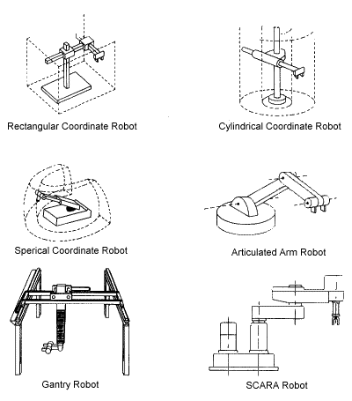
Types and Classification
Industrial robots are designed and fabricated with different design configurations and a different number of axes or degrees of freedom.

Slide 58
Types and Classification
Servo and Non-servo
All industrial robots are either servo or non-servo controlled. Servo robots are controlled using sensors that continually monitor the robot‘s axes and associated components for position and velocity. This feedback is compared to pre-taught information which has been programmed and stored in the robot's memory. Non-servo robots do not have the feedback capability, and their axes are controlled through a system of mechanical stops and limit switches.

Slide 59
Classification – Type of Path Generated
Point-to-Point Path
Robots programmed and controlled in this manner are programmed to move from one discrete point to another within the robot's working envelope. In the automatic mode of operation, the exact path taken by the robot will vary slightly due to variations in velocity, joint geometries, and point spatial locations. This difference in paths is difficult to predict and therefore can create a potential safety hazard to personnel and equipment.

Slide 60
Classification – Type of Path Generated
Controlled Path
The path or mode of movement ensures that the end of the robot's arm will follow a predictable (controlled) path and orientation as the robot travels from point to point. The coordinate transformations required for this hardware management are calculated by the robot's control system computer. Observations that result from this type of programming are less likely to present a hazard to personnel and equipment.

Slide 61
Classification – Type of Path Generated
Continuous Path
A robot whose path is controlled by storing a large number or close succession of spatial points in memory during a teaching sequence is a continuous path-controlled robot. During this time, and while the robot is being moved, the coordinate points in space of each axis are continually monitored on a fixed time base, e.g., 60 or more times per second, and placed into the control system's computer memory. When the robot is placed in the automatic mode of operation, the program is replayed from memory and a duplicate path is generated.

Slide 62
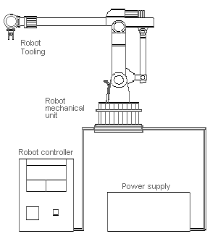
Classification – Robot Components
1) The mechanical unit, 2) power source, 3) control system, and 4) tooling

Slide 63
Classification – Robot Components
Mechanical Unit
The robot's manipulative arm is the mechanical unit. This mechanical unit is also comprised of a fabricated structural frame with provisions for supporting mechanical linkage and joints, guides, actuators (linear or rotary), control valves, and sensors. The physical dimensions, design, and weight-carrying ability depend on application requirements.

Slide 64
Classification – Robot Components
Power Sources
Pneumatic, hydraulic, or electrical power. The robot's drives are usually mechanical combinations powered by these types of energy, and the selection is usually based upon application requirements.
Hydraulic power transmission (high-pressure oil) is usually used for medium to high force or weight applications, or where smoother motion control can be achieved than with pneumatics. Consideration should be given to potential hazards of fires from leaks if petroleum-based oils are used.

Slide 65
Classification – Robot Components
Power Sources
Electrically powered robots are the most prevalent in industry. Either AC or DC electrical power is used to supply energy to electromechanical motor-driven actuating mechanisms and their respective control systems. Motion control is much better, and in an emergency an electrically powered robot can be stopped or powered down more safely and faster than those with either pneumatic or hydraulic power.

Slide 66
Classification – Robot Components
Control Systems
Either computers or embedded microprocessors are used for practically all control of industrial robots today. The control system performs the necessary sequencing and memory functions for on-line sensing, branching, and integration of other equipment. Programming of the controllers can be done on-line or at remote off-line.
Self-diagnostic capability reduces robot system downtime. Programming of robot controllers and systems has not been standardized by the robotics industry; therefore, the manufacturers use their own proprietary programming languages which require special training of personnel.

Slide 67
Classification – Robot Components
A program consists of individual command steps which state either the position or function to be performed, along with other informational data such as speed, dwell or delay times, sample input device, activate output device, execute, etc.
It is necessary to establish a physical or geometrical relationship between the robot and other equipment or work to be serviced by the robot. To establish these coordinate points precisely within the robot's working envelope, it is necessary to control the robot manually and physically teach the coordinate points. To do this as well as determine other functional programming information, three different teaching or programming techniques are used: lead-through, walk-through, and off-line.

Slide 68
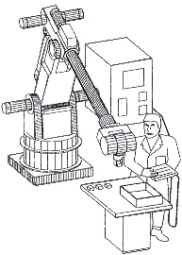
Classification – Robot Components
Lead-Through Programming or Teaching
The teach pendant can be the sole source by which a program is established, or it may be used in conjunction with an additional programming console and/or the robot's controller.

Slide 69
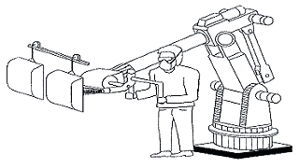
Classification – Robot Components
Walk-Through Programming or Teaching
A person doing the teaching has physical contact with the robot arm and gains control and walks the robot's arm through the desired positions within the working envelope

Slide 70
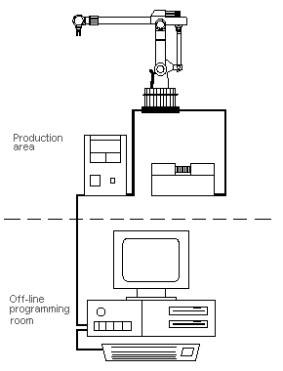
Classification – Robot Components
Off-Line Programming
The programming establishing the required sequence of functional and required positional steps is written on a remote computer console

Slide 71
Classification – Robot Components
Degrees of Freedom
Regardless of the configuration of a robot, movement along each axis will result in either a rotational or a translational movement. The number of axes of movement (degrees of freedom) and their arrangement, along with their sequence of operation and structure, will permit movement of the robot to any point within its envelope. Robots have three arm movements (up-down, in-out, side-to-side). In addition, they can have as many as three additional wrist movements on the end of the robot's arm: yaw (side to side), pitch (up and down), and rotational (clockwise and counterclockwise).

Slide 72
Classification – Robot Components
Degrees of Freedom
Regardless of the configuration of a robot, movement along each axis will result in either a rotational or a translational movement. The number of axes of movement (degrees of freedom) and their arrangement, along with their sequence of operation and structure, will permit movement of the robot to any point within its envelope. Robots have three arm movements (up-down, in-out, side-to-side). In addition, they can have as many as three additional wrist movements on the end of the robot's arm: yaw (side to side), pitch (up and down), and rotational (clockwise and counterclockwise).

Slide 73
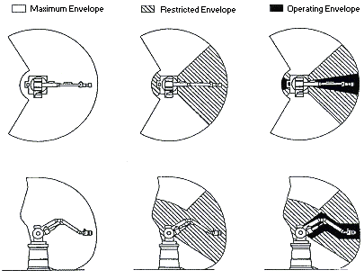
Hazards
Robots are capable of high-energy (fast or powerful) movements through a large volume of space. The pattern and initiation of movement of the robot is predictable only if the item being "worked" and the environment are held constant.

Slide 74
Hazards - Type of Accidents
Some maintenance and programming personnel may be required to be within the restricted envelope while power is available to actuators.
The restricted envelope of the robot can overlap a portion of the restricted envelope of other robots or work zones of other industrial machines and related equipment.
Thus, a worker can be hit by one robot while working on another, trapped between them or peripheral equipment, or hit by flying objects released by the gripper.

Slide 75
Hazards - Type of Accidents
Types of Accidents
Impact or Collision Accidents: unpredicted movements, component malfunctions, or unpredicted program changes
Crushing and Trapping Accidents: a worker's limb or other body part can be trapped between a robot's arm and other peripheral equipment
Mechanical Part Accidents: the breakdown of the robot's drive components, tooling or end-effector, peripheral equipment, or its power source is a mechanical accident
Other Accidents
Equipment that supplies robot power and control
Ruptured hydraulic lines, arc flash, metal spatter, dust, etc.

Slide 76
Hazards - Sources of Hazards
Human Errors
Inherent prior programming
Interfacing activated peripheral equipment
Connecting live input-output sensors to the microprocessor or a peripheral
The incorrect activation of the "teach pendant" or control panel is a frequent human error.
Over familiarity with the robot's redundant motions

Slide 77
Hazards - Sources of Hazards
Control Errors
Errors in software, electromagnetic interference, and radio frequency interference
Faults in the hydraulic, pneumatic, or electrical sub-controls associated with the robot or robot system
Unauthorized Access
Entry into a robot's safeguarded area is hazardous because the person involved may not be familiar with the safeguards in place or their activation status

Slide 78
Hazards - Sources of Hazards
Mechanical Failures
Operating programs may not account for cumulative mechanical part failure, and faulty or unexpected operation may occur
Environmental Sources
Electromagnetic or radio-frequency interference
Solutions to environmental hazards should be documented prior to equipment start-up

Slide 79
Hazards - Sources of Hazards
Power Systems
Pneumatic, hydraulic, or electrical power sources
Fire risks are increased by electrical overloads or by use of flammable hydraulic oil
Electrical shock and release of stored energy
Improper Installation
The design, requirements, and layout of equipment, utilities, and facilities of a robot or robot system, if inadequately done, can lead to inherent hazards

Slide 80
Investigation Guidelines
Manufactured, Remanufactured, and Rebuilt Robots
All robots should meet minimum design requirements
If older or obsolete robots are rebuilt or remanufactured, they should be upgraded
Every robot should be designed, manufactured, remanufactured, or rebuilt with safe design and manufacturing considerations. It is recommended that they comply with Section 4 of the ANSI/RIA R15.06-1992 standard for Manufacturing, Remanufacture, and Rebuild of Robots.

Slide 81
Investigation Guidelines
Installation
A robot or robot system should be installed by the users in accordance with the manufacturer's recommendations and in conformance to acceptable industry standards
Installation specifications
Physical facilities
Electrical facilities
Action of peripheral equipment integrated with the robot
Identification requirements
Control and emergency stop requirements
Special robot operating procedures or conditions

Slide 82
Control and Safeguarding Personnel
Risk Assessment
At each stage of development of the robot and robot system a risk assessment should be performed
The risk assessments for each stage of development should be documented for future reference
Safeguarding Devices
Mechanical limiting devices
Nonmechanical limiting devices
Presence-sensing safeguarding devices
Fixed barriers (which prevent contact with moving parts)
Interlocked barrier guards

Slide 83
Control and Safeguarding Personnel
Awareness Devices
Chain or rope barriers with supporting stanchions or flashing lights, signs, whistles, and horns
Safeguarding the Teacher
Special consideration must be given to the teacher or person who is programming the robot
During the teach mode of operation, the person performing the teaching has control of the robot and associated equipment and should be familiar with the operations to be programmed
ANSI/RIA R15.06-1992

Slide 84
Control and Safeguarding Personnel
Operator Safeguards
The system operator should be protected from all hazards during operations performed by the robot. When the robot is operating automatically, all safeguarding devices should be activated, and at no time should any part of the operator's body be within the robot's safeguarded area
For additional operator safeguarding suggestions, see the ANSI/RIA R15.06-1992 standard, Section 6.6

Slide 85
Control and Safeguarding Personnel
Attended Continuous Operation
When a person is permitted to be in or near the robots restricted envelope to evaluate or check the robots motion or other operations, all continuous operation safeguards must be in force. During this operation, the robot should be at slow speed, and the operator would have the robot in the teach mode and be fully in control of all operations
Other safeguarding requirements are suggested in the ANSI/RIA R15.06-1992 standard, Section 6.7

Slide 86
Control and Safeguarding Personnel
Maintenance and Repair Personnel
Safeguarding maintenance and repair personnel is very difficult because their job functions are so varied
Troubleshooting faults or problems with the robot, controller, tooling, or other associated equipment is just part of their job
While maintenance and repair is being performed, the robot should be placed in the manual or teach mode, and the maintenance personnel perform their work within the safeguarded area and within the robots restricted envelope
ANSI/RIA R15.06-1992 standard, Section 6.8

Slide 87
Control and Safeguarding Personnel
Maintenance
Maintenance should occur during the regular and periodic inspection program for a robot or robot system
An inspection program should include, but not be limited to, the recommendations of the robot manufacturer and manufacturer of other associated robot system equipment such as conveyor mechanisms, parts feeders, tooling, gages, sensors, and the like
It is recommended that periodic maintenance and inspections be documented along with the identity of personnel performing these tasks

Slide 88
Control and Safeguarding Personnel
Safety Training
Personnel who program, operate, maintain, or repair robots or robot systems should receive adequate safety training, and they should be able to demonstrate their competence to perform their jobs safely. Employers can refer to OSHA's publication 2254 (Revised), "Training Requirements in OSHA Standards and Training Guidelines."

Slide 89
Control and Safeguarding Personnel
General Requirements
The following sections of the ANSI/RIA R15.06-1992 must also be considered:
Section 6 - Safeguarding Personnel
Section 7 - Maintenance of Robots and Robot Systems
Section 8 - Testing and Start-up of Robots and Robot Systems
Section 9 - Safety Training of Personnel
Robots or robotic systems must comply with the following regulations: Occupational Safety and Health Administration, OSHA 29 CFR 1910.333, Selection and Use of Work Practices, and OSHA 29 CFR 1910.147, The Control of Hazardous Energy (Lockout/Tagout)

Slide 90
Other Robots
Service robots
Machines that extend human capabilities
Automatic guided-vehicle systems
Advanced material-handling or conveying systems that involve a driverless vehicle which follows a guide-path
Undersea and space robots
These vehicles are called remotely operated vehicles (ROV's) or autonomous undersea vehicles (AUV's); the feature that distinguishes them is, respectively, the presence or absence of an electronics tether that connects the vehicle and surface control station

Slide 91
Other Robots
Automatic storage and retrieval systems
Storage racks linked through automatically controlled conveyors and an automatic storage and retrieval machine or machines that ride on floor-mounted guide rails and power-driven wheels
Automatic conveyor and shuttle systems
Various types of conveying systems linked together with various shuttle mechanisms for the prime purpose of conveying materials or parts to prepositioned and predetermined locations automatically

Slide 92
Other Robots
Teleoperators
Robotic devices comprised of sensors and actuators for mobility and/or manipulation and are controlled remotely by a human operator
Mobile robots
Freely moving automatic programmable industrial robots
Prosthetic robots
Programmable manipulators or devices for missing human limbs
Numerically controlled machine tools

